Slide 1

Social Media Assistance Packet
Child and Adult Care Food Program (CACFP) Week
This Social Media Assistance Packet provides social media posts (images and text) to make it easy to share your National CACFP Week celebrations! Use the best practices below, along with the copy-and-paste images and posts, to spread awareness on the importance of the program in providing nutritious meals for participating children and adults!
Social Media Best Practices
Keep these best practices in mind when planning social media content, whether it’s for your website, Facebook, Twitter, or Instagram!
Your Audience includes parents/caregivers, children, local media, and community leaders. Language and content should be tailored to reach your intended audience. Always keep the reader in mind as you write. Every message should be easy for your audience to read.
Use Photos, Videos, or GIFs to add visual appeal and capture attention. Use the images we provided or add your own!
Live Feeds, Reels, and Stories offer ways to add interactive elements and further engage your audience.
A Social Media Tag creates a short link to a profile and the post may be added to that person’s or group’s timeline. This makes your posts easier to find! This can also help reach media and local officials. Consider tagging local news outlets, radio stations, and your local mayor.
Don’t Forget to Tag TDA on Social Media!
  Twitter: @TexasDeptofAg
  Facebook: TexasDepartmentofAgriculture
  Instagram: @texasagriculture
  Hashtags: #TXCACFP #CACFPWeek

Slide 2




Copy-and-Paste
Images and Posts
POST #1
Coming Soon - National CACFP Week is two weeks away! Join us in recognizing the importance of the program in providing nutritious meals to children and adults! Visit SquareMeals.org/CACFPWeek for more information. #TXCACFP #CACFPWeek
cv
POST #2
Get ready to celebrate - Next week is National CACFP Week! Join us in celebrating this program that provides children and adults with nutritious meals! Visit SquareMeals.org/CACFPWeek for more information. #TXCACFP #CACFPWeek
POST #3
Today kicks off National CACFP Week! Celebrate with us as we recognize the efforts of providers and serve delicious, nutritious meals to children and adults all week long! Find more information about National CACFP Week by visiting SquareMeals.org/CACFPWeek #TXCACFP #CACFPWeek

Slide 3


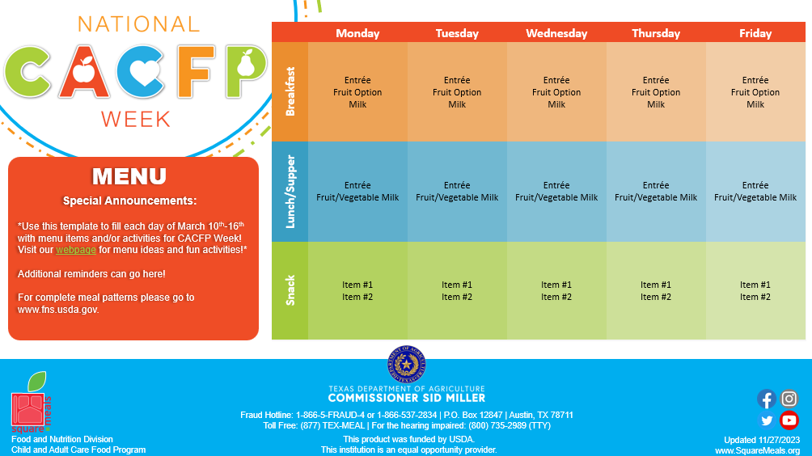

Copy-and-Paste
Images and Posts
POST #4
Attention Parents and Caregivers - It is National CACFP Week! Check out this postcard for information on this week’s celebration and be on the lookout for fun activities and nutritious meals enjoyed by your children! For more information, visit SquareMeals.org/CACFPWeek. #TXCACFP #CACFPWeek
cv
POST #5
Check out our celebration menu for National CACFP Week! We are serving fun, nutritious foods all week long and participating in nutrition-based activities! Visit SquareMeals.org/CACFPWeek for more information. #TXCACFP #CACFPWeek
POST #6
Thank you for celebrating with us - check out what we did all week long! Join us again next year for National CACFP Week 2025! Visit SquareMeals.org/CACFPWeek for more information. #TXCACFP #CACFPWeek

